Slide 1

Bioinformatic formats and RNA-seq workflow
Adam Cribbs

Slide 2
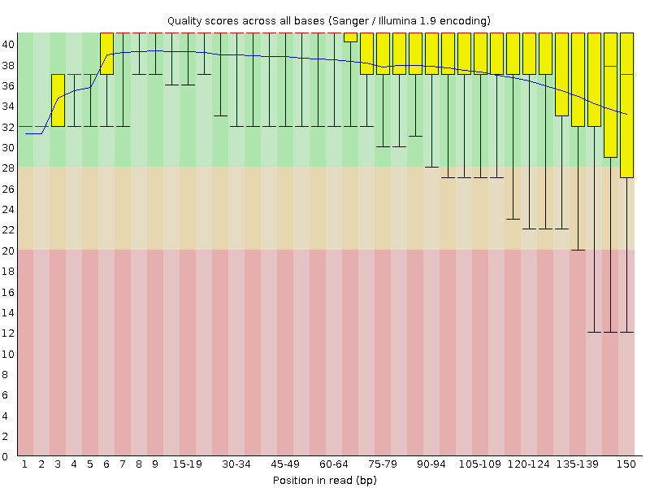
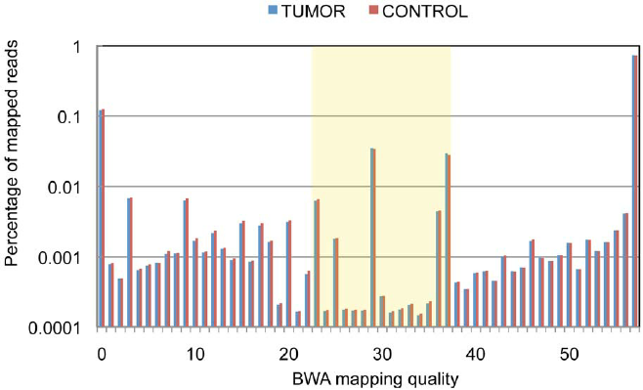
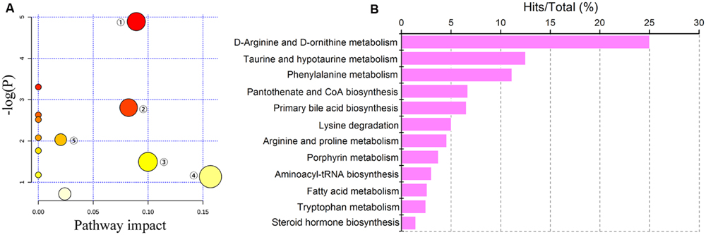
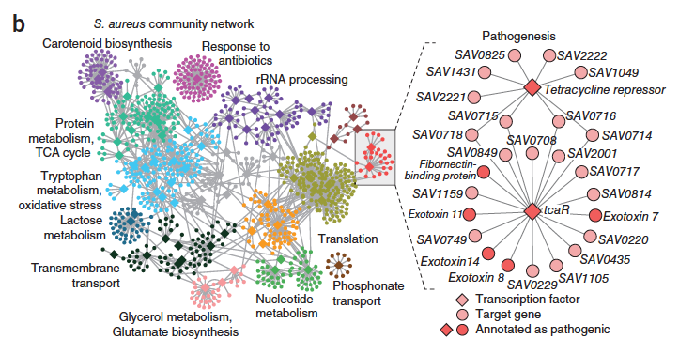
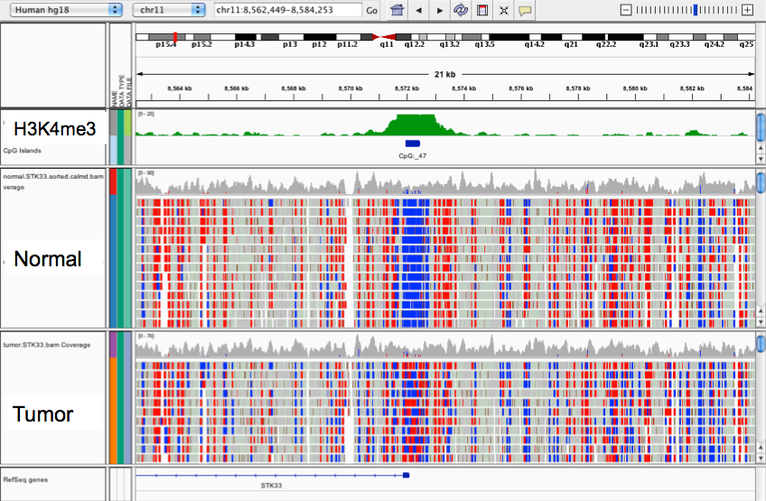
NGS data analysis – RNA-seq
Raw reads from sequencer
Quality assessment of reads
Mapping
Pathway
analysis
Gene
networks
Data storage and visualisation

Slide 3
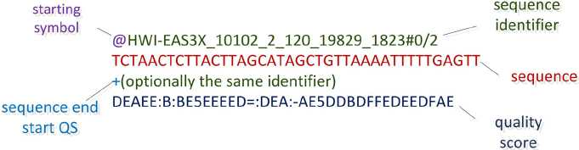
Quality control of fastq reads
Sequencing output:
Reads + quality
Flat files – are very large – inefficient but it’s the standard
Question: is the quality of my sequencing data good?

Slide 4
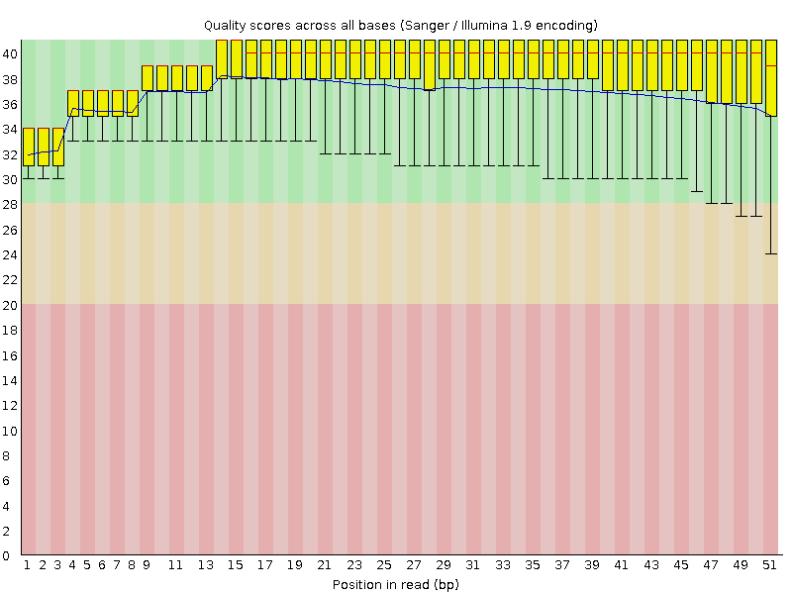
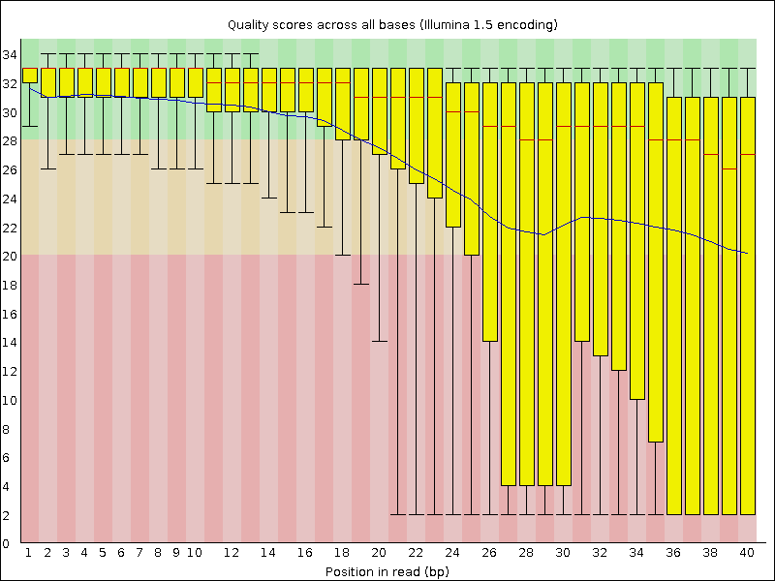
Quality control of fastq reads
Fastqc – babraham institute
https://www.bioinformatics.babraham.ac.uk/projects/fastqc/

Slide 5
Tools to deal with read QC
Fastx-toolkit to optimize different datasets
Fastq-screen – check that all of your data is not contaminated
Trimming to improve quality
Trimmomatic
Cutadapt
There are many many more!
But beware of removing too many reads or trimming too much

Slide 6
Mapping reads to the genome/transcriptome
Mapping data is very important to get correct
Many different mappers – make sure you use the latest software
Always treat your samples consistently
Main issues:
Number of mismatches
Number of multi-hits
Mates expected distance
Exon junction

Slide 7
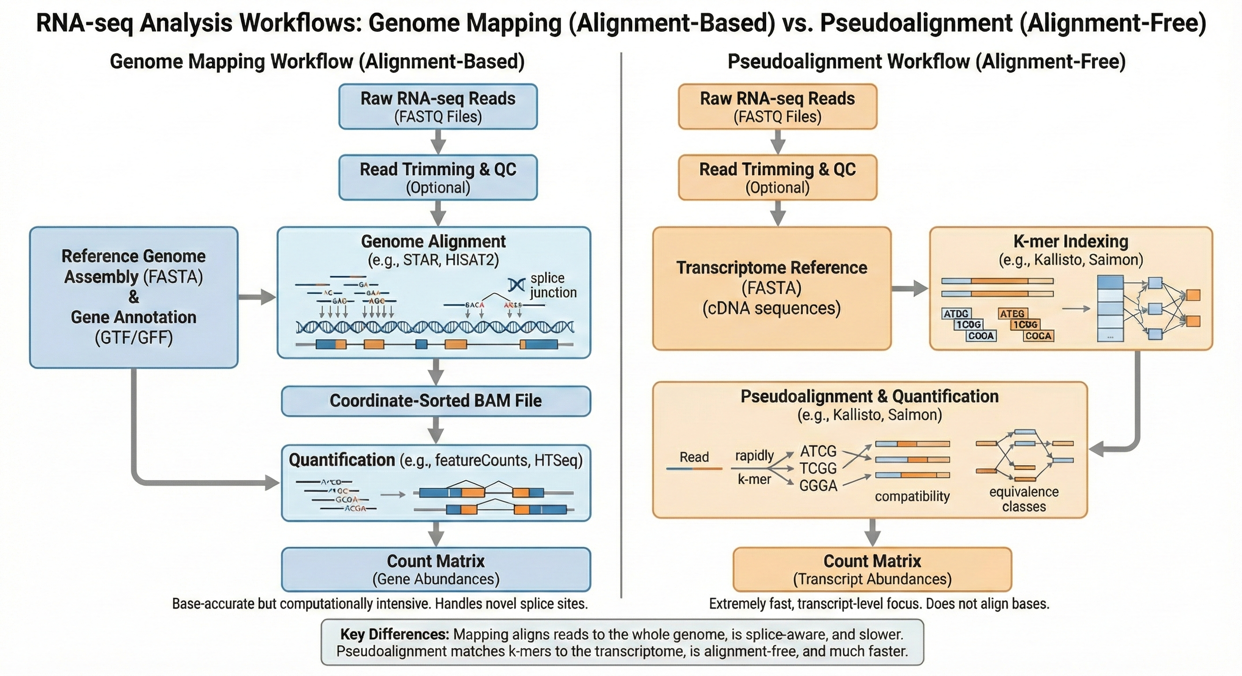
RNA-seq analysis workflow: Genome vs Transcriptome

Slide 8
Gene Transfer File (GTF) for mapping

Slide 9
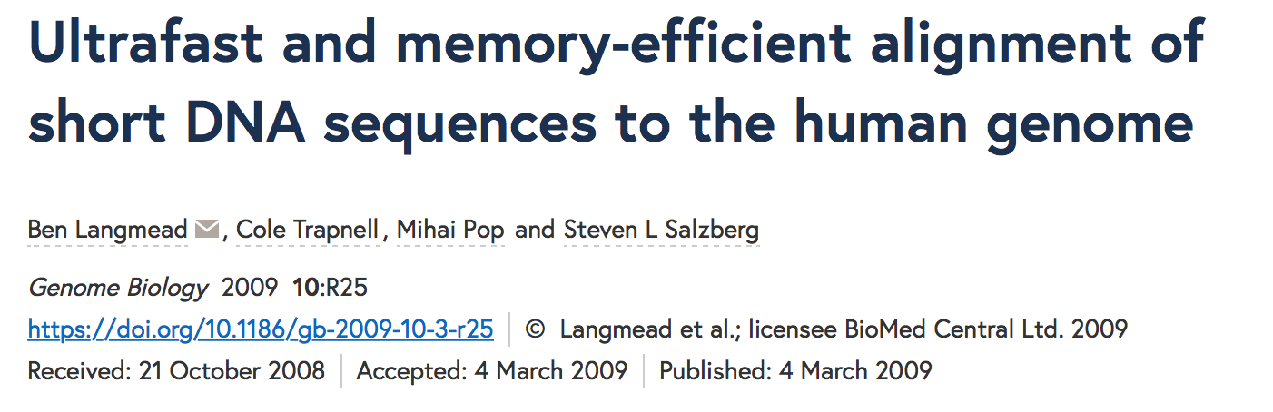
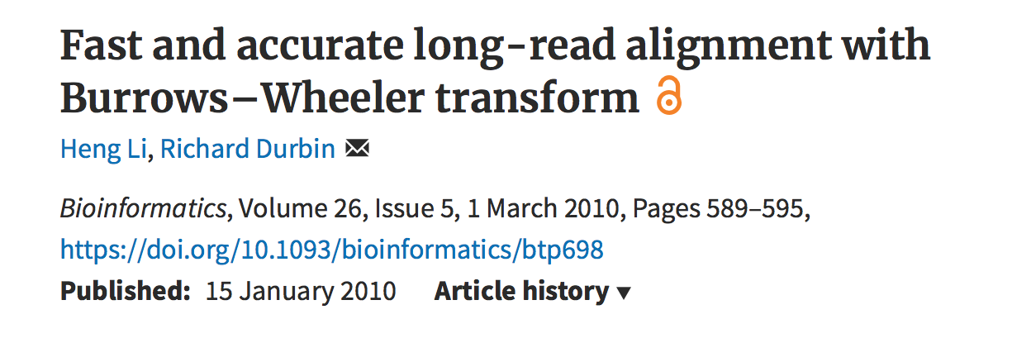
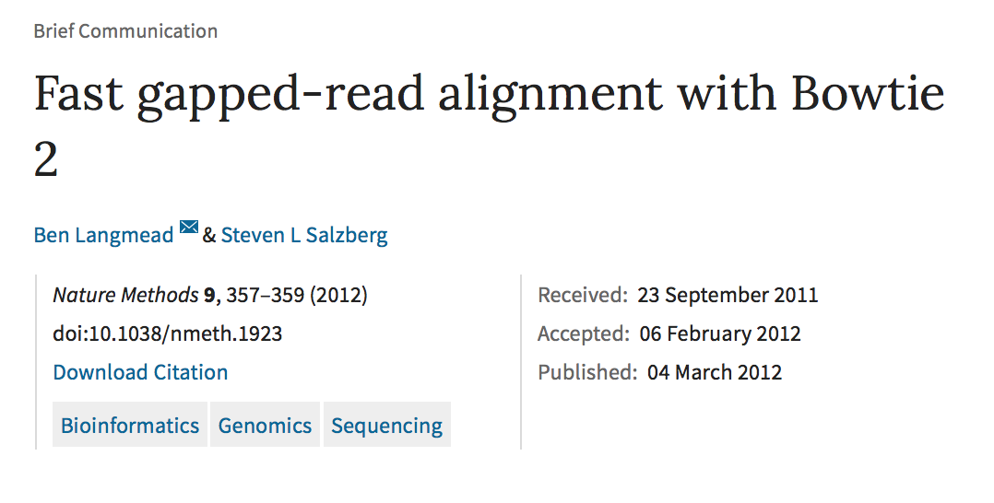
Mapping reads to genome
Which one to use???
Depends on application

Slide 10
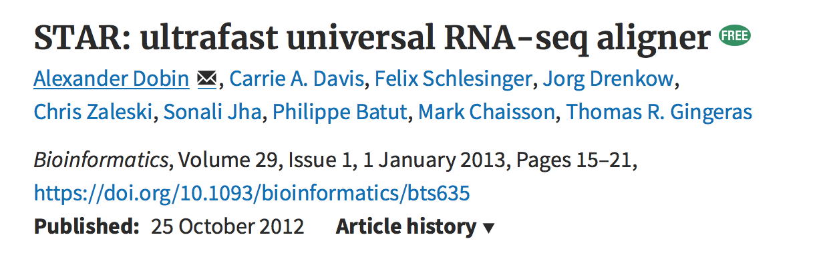
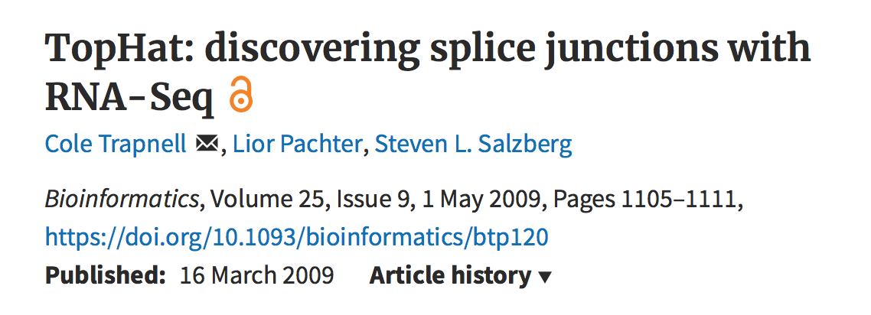
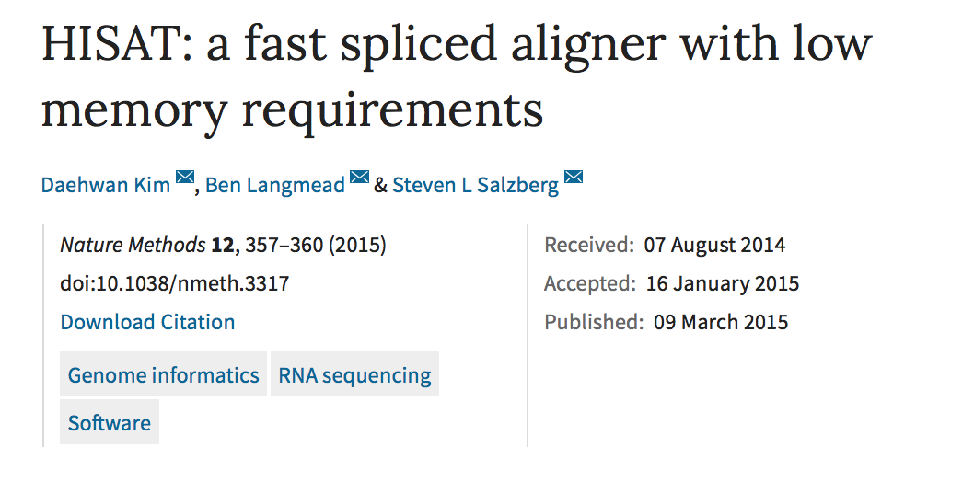
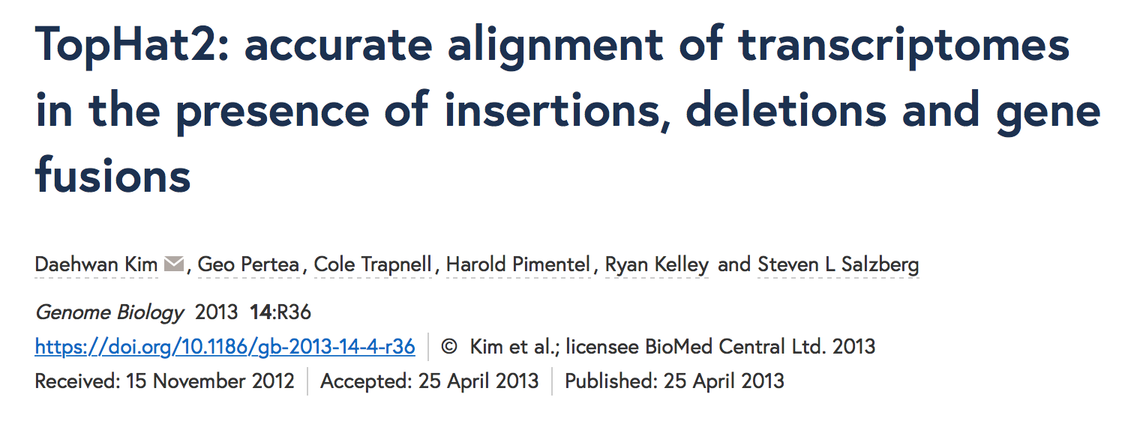
Mapping reads to transcriptome
Which one to use???
Depends on application
Don’t use tophat or hisat – use Tophat2 and hisat2

Slide 11
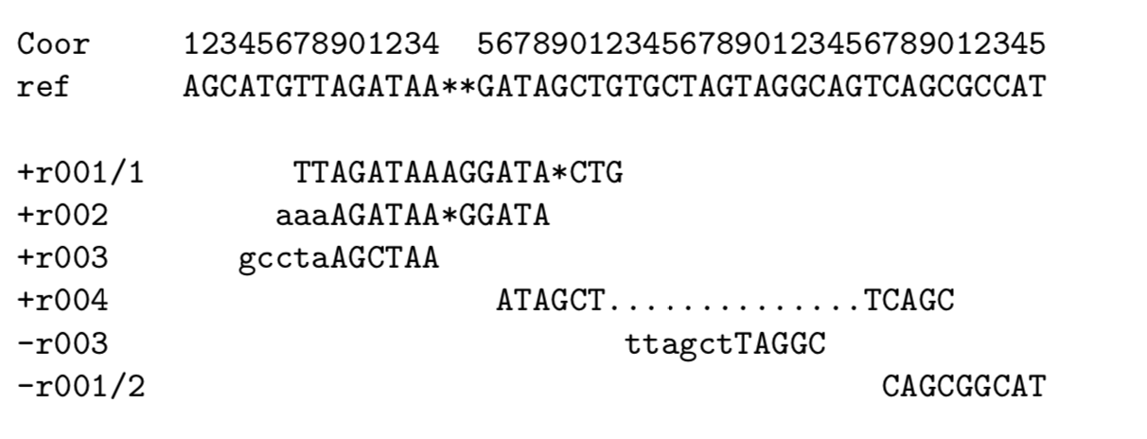
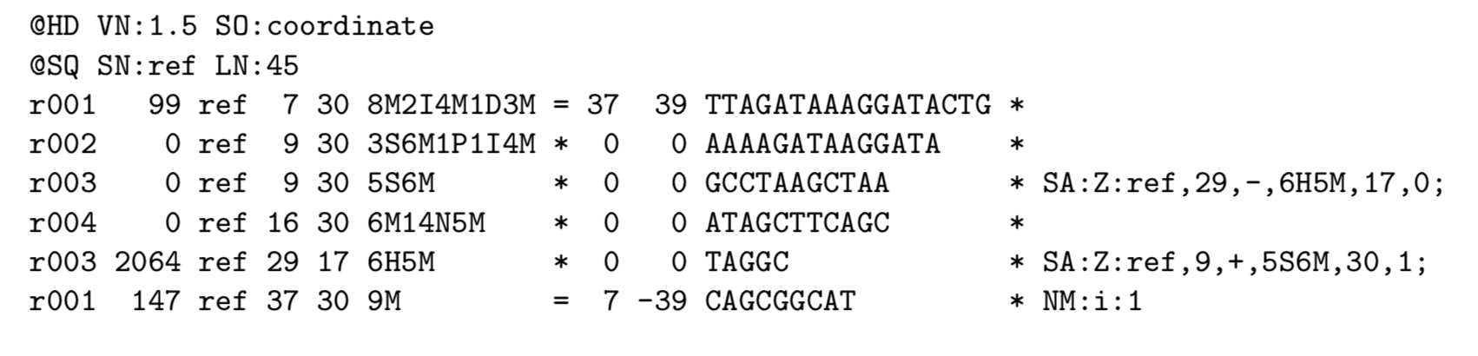
Sequence Alignment Map/BAM format
Standard mapping output
Sequence alignment map (SAM)
Tab delimited
11 mandatory fields
1. Read name
10. Seq
2. Flag
4. Position
6. Cigar
8. Pos of mate
3. Reference
5. Quality
7. Ref name of mate
9. Template len

Slide 12
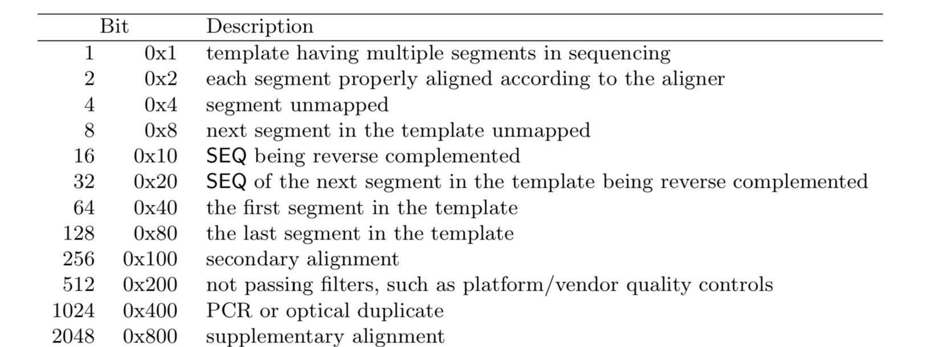
Sequence Alignment Map/BAM format
FLAG
CIGAR

Slide 13
Sequence Alignment Map/BAM tools
Commandline
Samtools
view
Index
Sort
Picard
MarkDuplicates
Python
Pysam

Slide 14
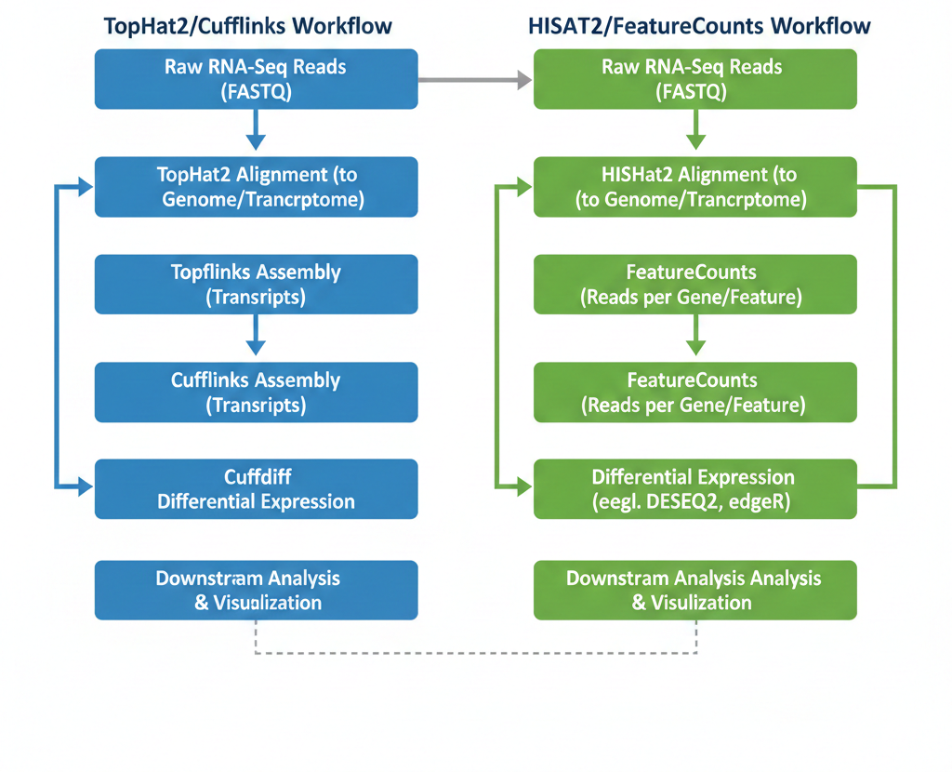
RNA-seq workflow - mapping
Workflow 1: The "Old Tuxedo" Suite
Tophat2 → Cufflinks → Cuffdiff → Cuffmerge
This workflow was revolutionary because it focused on transcript-level analysis. It doesn't just count reads against known genes; it tries to assemble the pieces to see what the transcripts actually look like.
Workflow 2: The "New Tuxedo" Count-Based Suite
HISAT2 → FeatureCounts → DESeq2/EdgeR
This is currently the most widely used approach for standard differential expression. It relies on a "count-and-test" philosophy using a fixed annotation (like Gencode or Ensembl).
Workflow 2 best for 95% of use cases

Slide 15
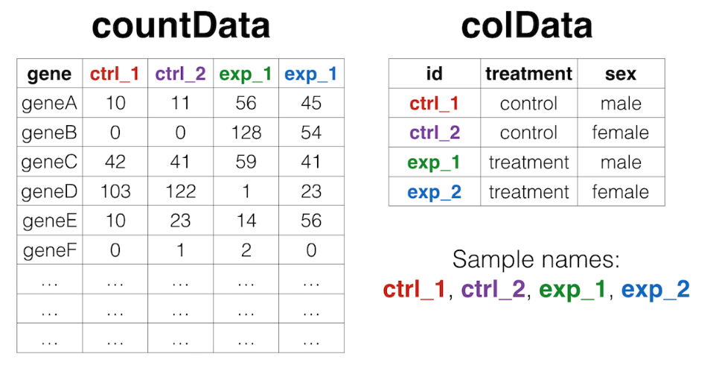
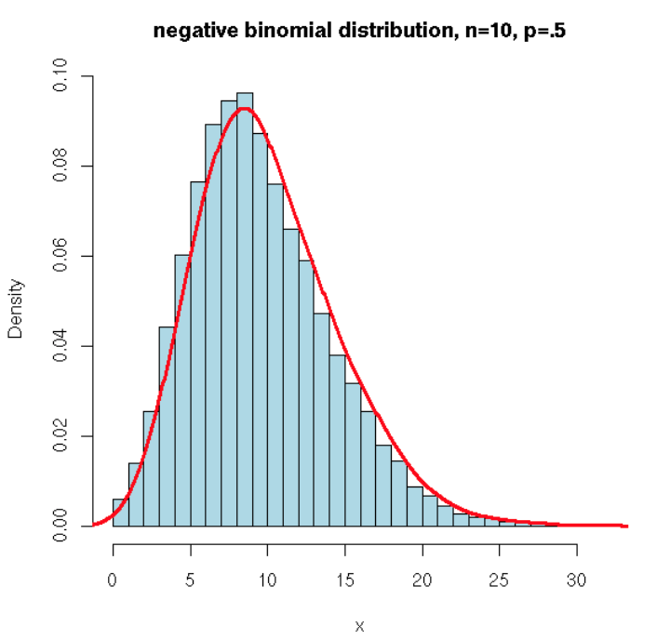
Counts data
Following featurecounts you are left with a counts table
Fewer genes with large counts and more with fewer counts

Slide 16
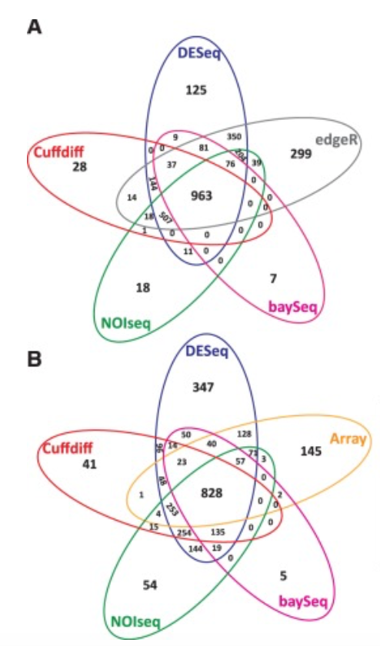
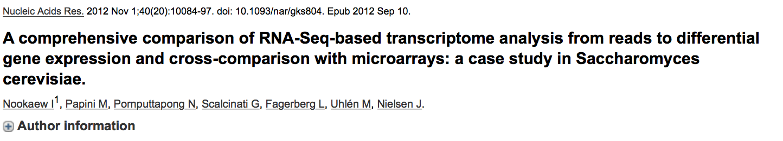
DEG methods
Which model to use????
My preference is DESeq2
Well written and better support
edgeR not accounting for typeI errors as well?
Microarray
RNA-seq

Slide 17
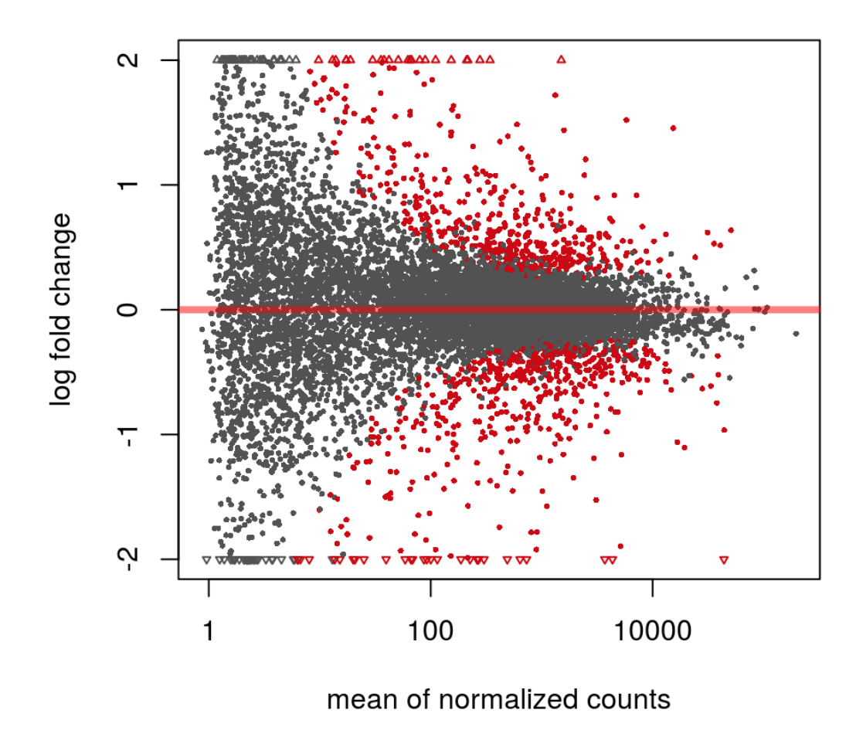
DESeq2 model
Model overview:
First fits a GLM to the data using a sample size factor
Cooks distance for counts outlier detection
Dispersion is measured
zero-centered normal prior to shrink lower end
Wald test or LRT test

Slide 18
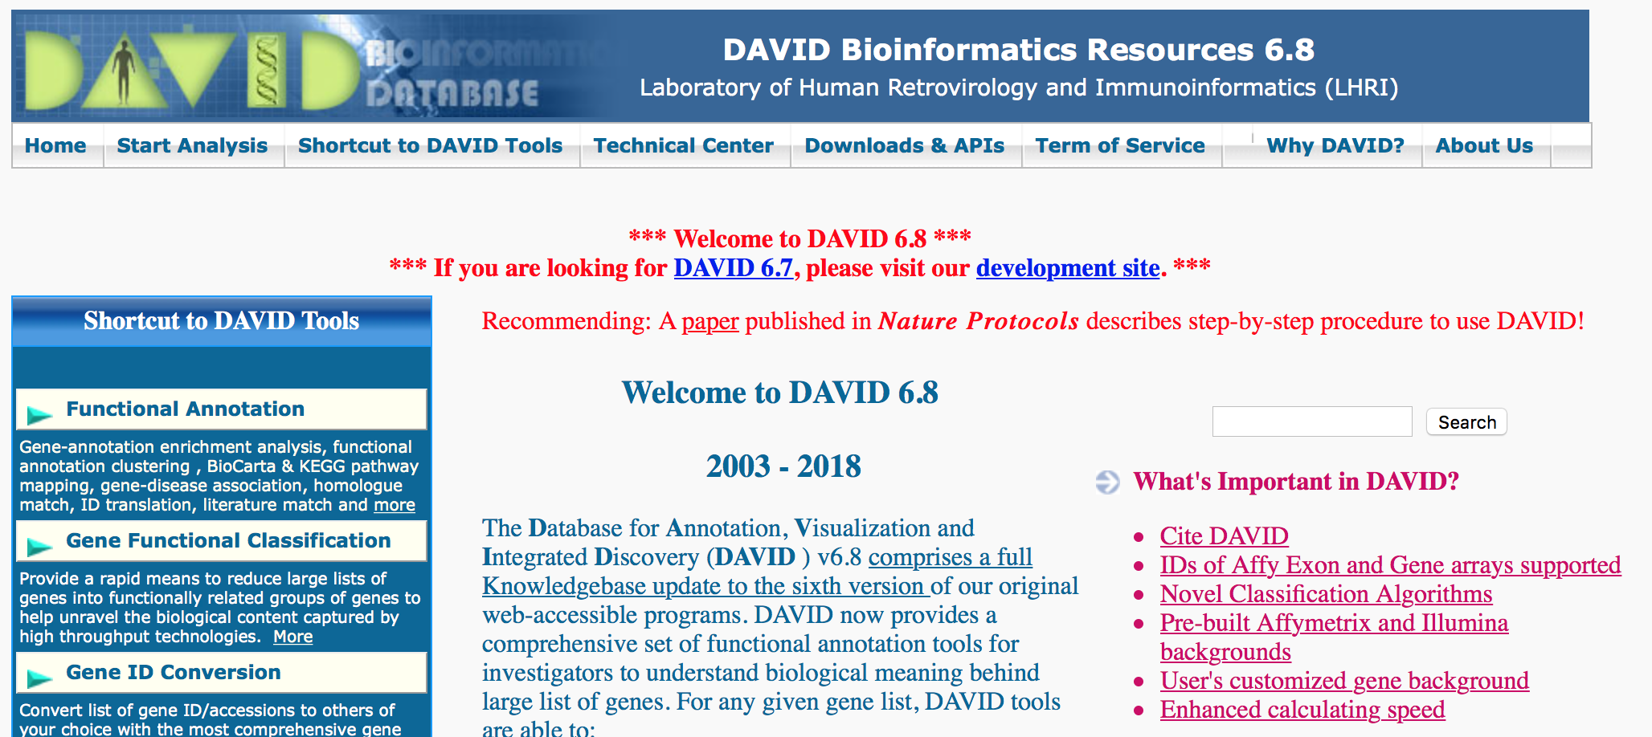
Pathway analysis
Pathway analysis helps to identify novel pathways that may be disease relevant
Skewed towards cancer
Not always informative
Paid vs public

Slide 19
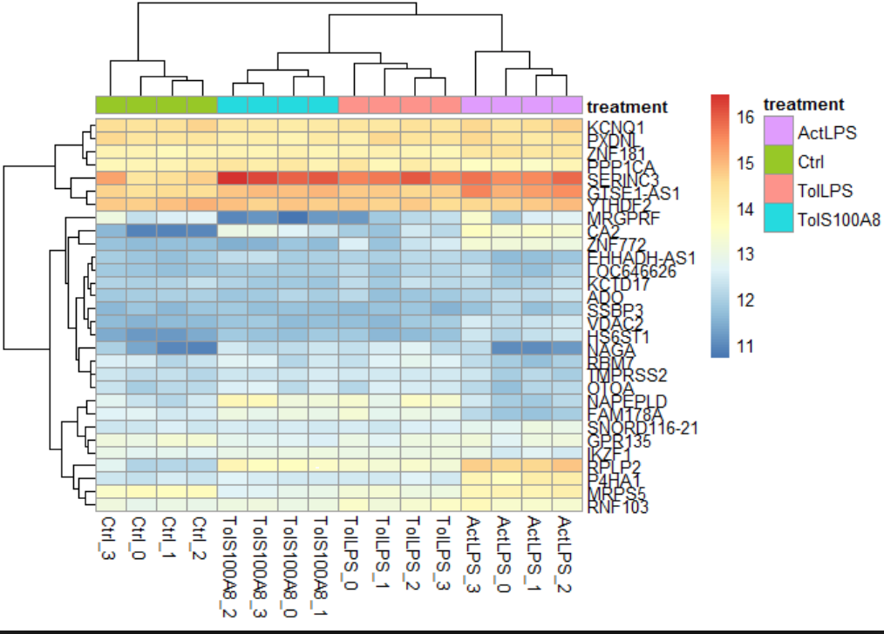
Biological interpretation
The most important part and most difficult
Can be a problem when outsourcing
Language barrier between biologist and bioinformatician
Visualising data helps overcome this
Many different roads to Rome

